Slide 1
2021 MLP 04.08
Yonsei University
Machine Learning Project Team 09

Slide 2
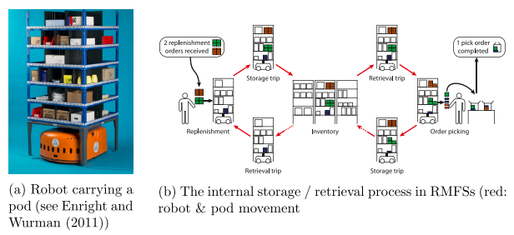
Background
RMFS(The Robotic Mobile Fulfillment System)
Automated parts-to-picker system
Robots transport movable shelves, called “pods”, that contain the inventory, back and forth between the storage area and the workstations

Slide 3
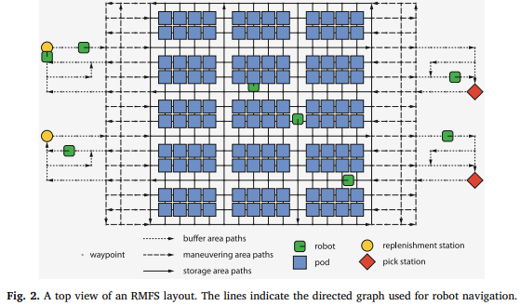
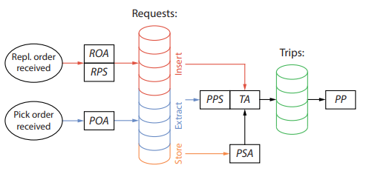
Background
RMFS(The Robotic Mobile Fulfillment System)
RAWSIM-O : Agent-based discrete-event simulation framework
Has a few decision rules for each problem
ROA : Replenishment Order Assignment
RPS : Replenishment Pod Selection
POA : Pick Order Assignment
PPS : Pick Pod Selection
PSA : Pod Storage Selection
TA : Task Allocation
PP : Path Planning

Slide 4
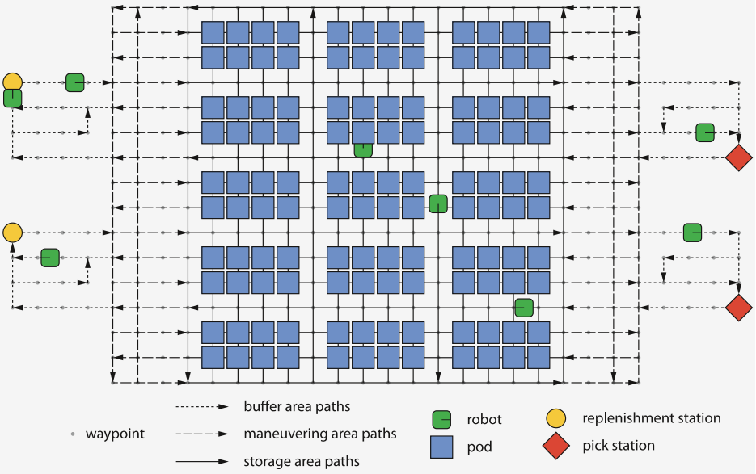
Proposal – Item classification
Existing Research
There is no existing research about PSA(Pod Storage Assignment)
In RAWSIM-O, There are 5 mode for PSA
Random, Fixed, Nearest, Station-Based, Class
Suggestion
Add a Machine learning Decision rule in PSA
Which part of the Storage is more efficient when Pods go back to Storage area
The number of Pick order, Replenishment order, Remaining items in a Pod as inputs
3 part of the storage area as outputs

Slide 5
Proposal – Item classification
Benefit
Applying Machine learning in PSA
Expect to reduce time when Pods go to stations
Expect to reduce unnecessary movements of the robot
Limitation
Hard to get reliable Dataset
Implementation to RAWSIM-O code(C#)

